Slide 1
Unit 4
Environmental pollution
Lecture 18 and 19
(Pollution case studies)

Slide 2
Learning outcomes
After completing this lecture, you will be able to understand the following:
Student get knowledge about different type of pollutions, their effect and solutions.
Student understand the basics problems and effects of pollution by the use of Pollution case studies.

Slide 3
Pollution Case Studies
The Bhopal Gas Tragedy
Chernobyl Nuclear Disaster
Ganga water pollution

Slide 4
Case Study on Bhopal Gas Tragedy

Slide 5
Preview-
Amongst the worst Industrial Disasters of its time.
Occurrence: 3rd December 1984.
Place of occurrence: Bhopal, Madhya Pradesh, India.
Company: Union Carbide Corporation.
Chemical: Methyl Isocyanate (40 tons)
People Affected- >500,000
People Died- ~40,000

Slide 6
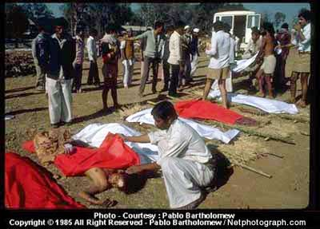
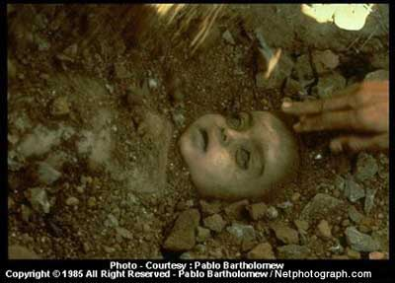
About 550,000 people were exposed to the gas. A government affidavit in 2006 stated the leak caused 558,125 INJURIES including 38,478 TEMPORARY PARTIAL INJURIES and approximately 3,900 SEVERELY AND PERMANENTLY DISABLING INJURIES

Slide 7
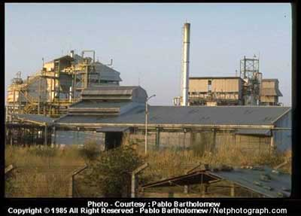
Bhopal Scenario
Union
Carbide
Corporation
Plant

Slide 8
Effects on Human Health.
Respiratory Disorders – Irritation to the lungs, causing coughing and/or shortness of breathing. Higher exposure caused build up of fluids (pulmonary enema). Caused Asthma.
Cancer Hazard – Caused mutation (genetic changes). It caused cancer.
Reproductive Hazard – Association between exposure to Methyl isocyanate and miscarriages. It may damage the growing fetus. May also affect fertility in men and women.
After Effect- Traces of many toxins were found in the Brest Milk of mothers and were in turn transmitted to the recipient babies.

Slide 9
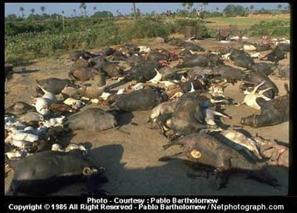
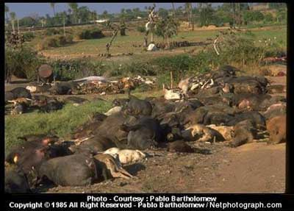
Animal Slaughter
2,000 buffalo, goats, and other animals died.

Slide 10
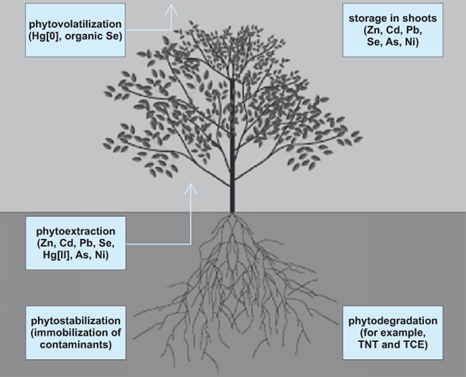
Toxic Materials in Soil and Water
Lead, Nickel, Copper, Chromium, hexachlorocyclohexane and chlorobenzenes were found in soil samples.
Mercury was found to be between 20,000 to 6,000,000 times the standard level in soil.

Slide 11
Toxic materials found in Soil and Water after the accident
Benzene, oxides | 7, 890
Dichlorobenzenes | 87,500
Polynuclear Aromatic Hydrocarbons | 2,340
Phthalates | 9,940
Trichlorobenzenes | 9,410
Trimethyl Trianzintrione | 24,470
1-Napthalenol | 59,090
Units in parts per billion (ppb)
Additionally, Dichlorobenzene and Trichlorobenzenes were found in the soil and water samples.

Slide 12
Compensation and Legal Aspects
Compensation of $470 million ($500 per dead).
Twenty years of passiveness.
Case was reviewed and put up in American Court.
In order to provide safe drinking water to the population around the UCIL factory, Government of Madhya Pradesh presented a scheme for improvement of water supply.
Supreme court directed the UCC and M.P. govt. to take immediate steps for disposal of toxic waste lying around and inside the factory.

Slide 13
20,000 KILLED
550,000 SEVERELY AFFECTED
…And you thought only weapons
could cause Mass Destruction.
https://www.youtube.com/watch?v=lUuKocuJtBM

Slide 14
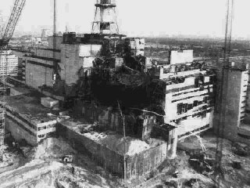
Chernobyl disaster
The worst manmade disaster in human history

Slide 15
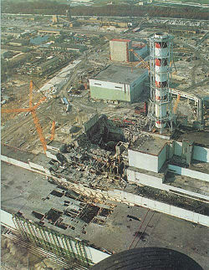
Examples of Nuclear Accidents
Chernobyl Disaster
Occurred on 26 April 1986 at the Chernobyl Nuclear Power Plant in Ukraine.
Consequences
4,000 civilian deaths
More than 200,000 cancer deaths

Slide 16
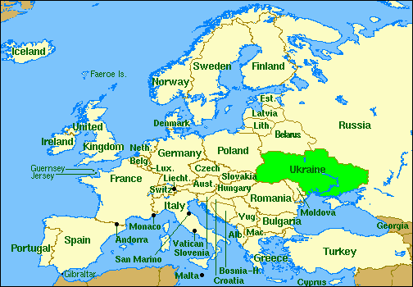
Where is Chernobyl?

Slide 17
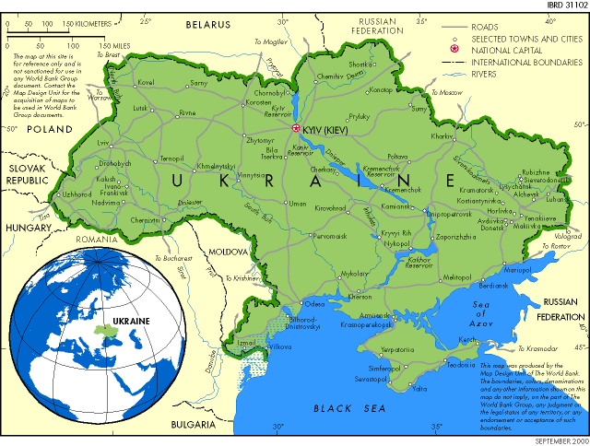
Chernobyl
Built in 1978-1979
Chornobyl

Slide 18
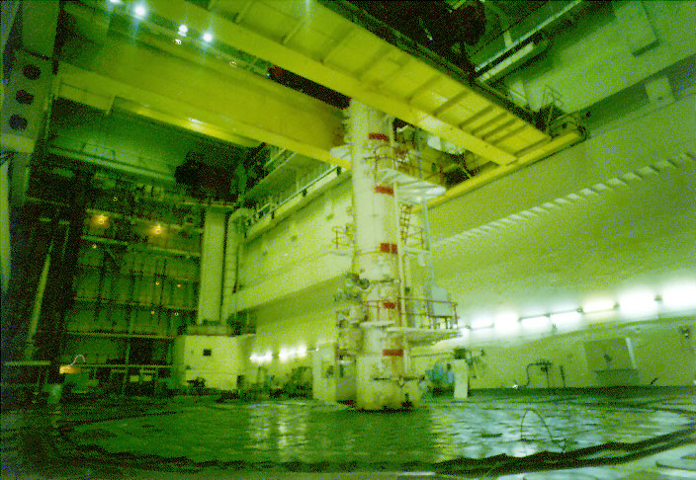
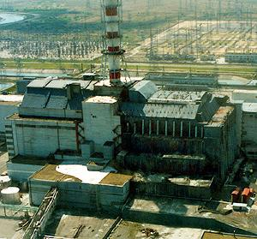
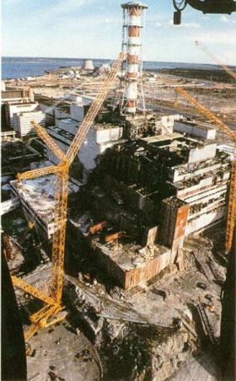

Slide 19
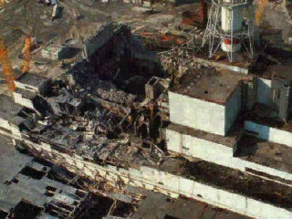
Summary of Facts
April 26, 1986:
  Chernobyl nuclear power plant
    Operator errors cause a reactor explosion
    Explosion releases 190 tons of radioactive gasses into the atmosphere
    Fire starts that lasts 10 days
People:
  7 million lived in contaminated areas; 3 million were children
Wind:
  Carries radiation far distances

Slide 20
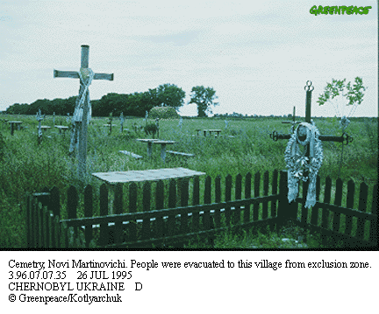
Direct Casualties
5.5 million people still live in contaminated areas
31 people died in 3 months of radiation poisoning
134 emergency workers suffered from acute radiation sickness
25,000 rescue workers died since then of diseases caused by radiation
Cancer afflicts many others
Increased birth defects, miscarriages, and stillbirths

Slide 21
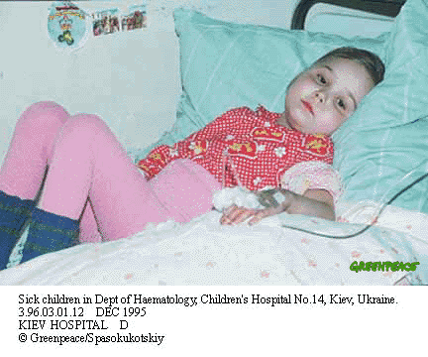
Indirect Casualties
  By the year 2000 there were 1800 case of thyroid cancer in children and adolescent
  High number of suicide and violent death among Firemen, policemen, and other recovery workers

Slide 22
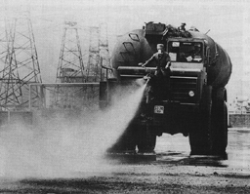
Environment Impact
Areas still impacted today:
  Soil
  Ground Water
  Air
  Food
    Crops
    Livestock

Slide 23
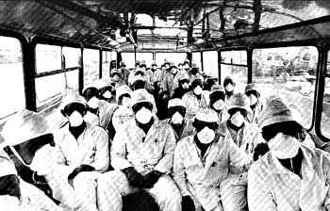
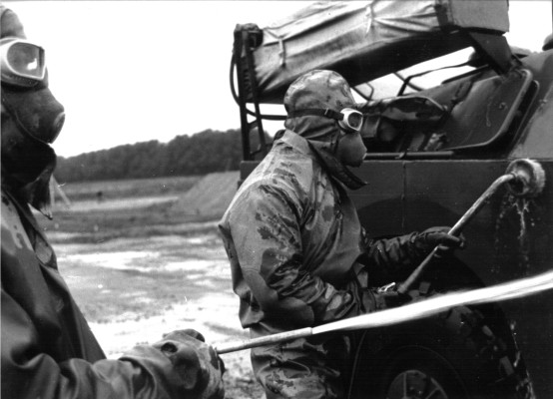
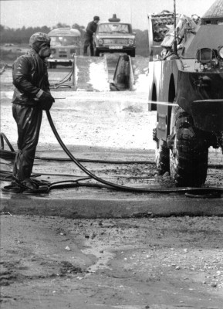
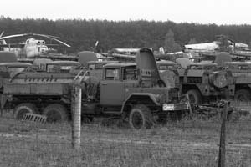

Slide 24
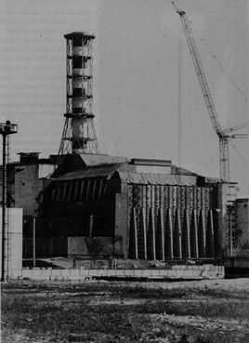
Solutions
The Sarcophagus
  After the disaster, a huge cement box was built around the radioactive material
  It is falling apart!

Slide 25
Recommendations for control on nuclear accident in future
Have proper Standard Operating Procedures (SOP) for both normal and emergency situations
Have scheduled trainings and practices for normal and emergency situations
Always have a reactor expert on site
Have a team work kind of environment such that every body is involved
https://www.youtube.com/watch?v=3dzfw6R97Fs

Slide 26
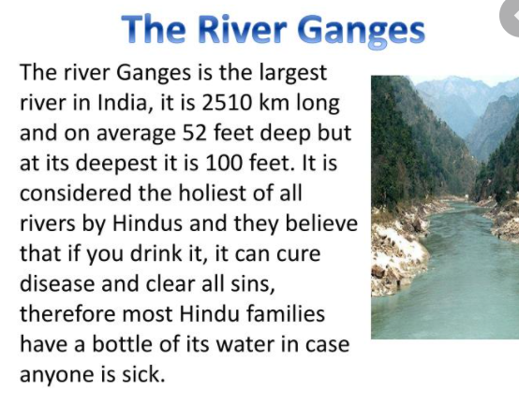

Slide 27
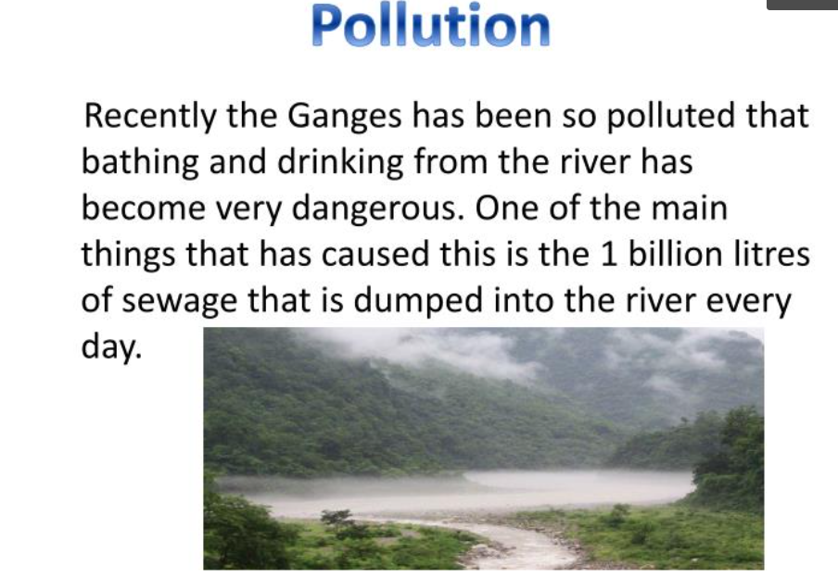

Slide 28
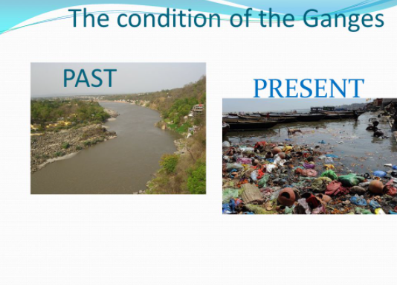
The main cause of water pollution in the Ganga river is the increase in the industrial waste into the rivers. Other minor pollutants are produced by people using the river as a natural resource of water.

Slide 29
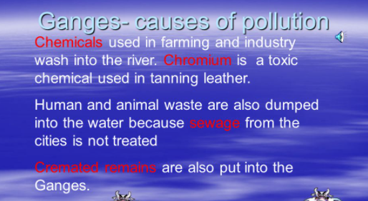
https://www.youtube.com/watch?v=qUFqRcBfxjc

Slide 30
Control of Ganga water pollution
Ganga water pollution can be controlled by following initiatives
Sewerage Treatment Infrastructure.
River-Front Development.
River-Surface Cleaning.
Afforestation of bank of river.
Public Awareness.
Industrial Effluent Monitoring.

Slide 31
Control of Ganga water pollution
Government initiatives taken for Ganga water pollution Control.
National Ganga River Basin Authority (NGRBA): NGRBA functions include development of a Ganga River Basin Management Plan, regulation of activities aimed at prevention, control and abatement of pollution, to maintain water quality and to take measures relevant to the river ecology in the Ganga basin states

Slide 32
Namami Gange Programme
‘Namami Gange Programme’, is an Integrated Conservation Mission, approved as ‘Flagship Programme’ by the Union Government in June 2014 with budget outlay of Rs.20,000 Crore to accomplish the twin objectives of effective abatement of pollution, conservation and rejuvenation of National River Ganga.
https://www.youtube.com/watch?v=Cz9fPUe1E6I

Slide 33
Important Video and Web Link
http://www.creationconcepts.org/resources/NUCLEAR.pdf
https://www-pub.iaea.org/MTCD/publications/PDF/Pub913e_web.pdf

Slide 34
Acknowledgment
Some images, animation, and material have been taken from the following sources:
Text Books: PERSPECTIVE IN ENVIRONMENTAL STUDIES by ANUBHA KAUSHIK, C P KAUSHIK, NEW AGE INTERNATIONAL PUBLISHERS
References Book: TEXT BOOK OF ENVIRONMENTAL STUDIES by D. DAVE AND S. S. KATEWA, CENGAGE LEARNING
3 All slides can be used for reading purpose only

